Slide 1
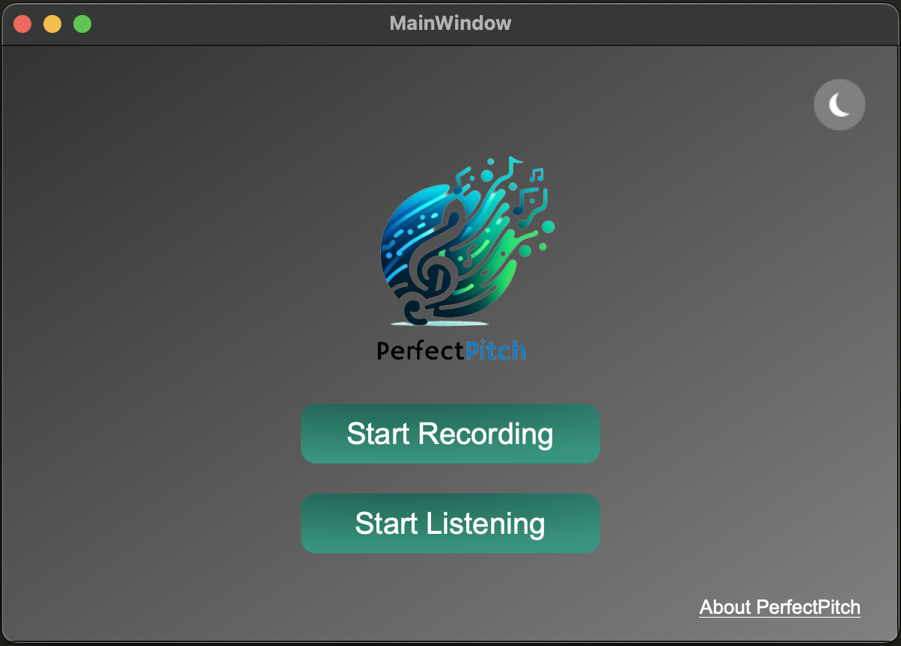

PerfectPitch – Online Melody Identifier
nd.
Computacional Áudio – 2 of Master in Electrical and Computer Engineering
Professor Doctor Diamantino Rui da Silva Freitas
André de Azevedo Barata
André Nogueira Soares
Eng. Eletrotécnica e de Computadores, Faculdade de Engenharia da Universidade do Porto
Porto, Portugal, up20190705@up.pt
Eng. Eletrotécnica e de Computadores, Faculdade de Engenharia da Universidade do Porto
Porto, Portugal, up201905318@up.pt
1

Slide 2
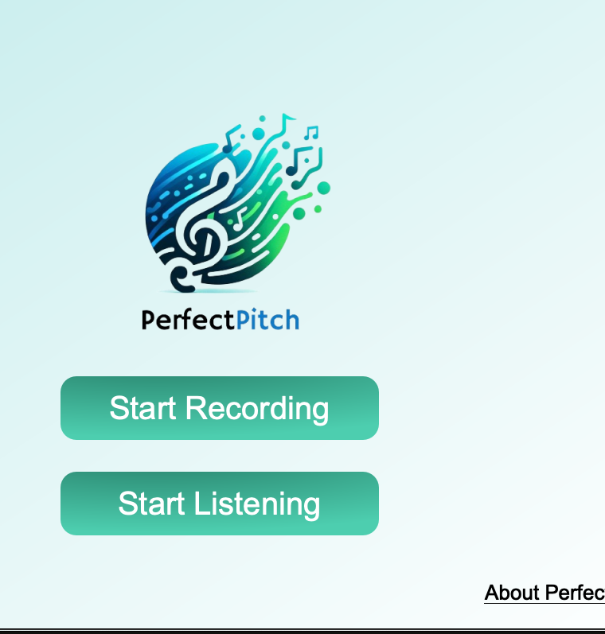
PerfectPitch – Online Melody Identifier
nd.
Computacional Áudio – 2 of Master in Electrical and Computer Engineering
Professor Doctor Diamantino Rui da Silva Freitas
André de Azevedo Barata
André Nogueira Soares
Eng. Eletrotécnica e de Computadores, Faculdade de Engenharia da Universidade do Porto
Porto, Portugal, up20190705@up.pt
Eng. Eletrotécnica e de Computadores, Faculdade de Engenharia da Universidade do Porto
Porto, Portugal, up201905318@up.pt
1

Slide 3
Index
1
1
2
3
4
5
Problem description
State of the Art solutions
Adopted solution
Implementation
Final result
Test - Pitch recognition
Pitch Recognition
Pitch Detection Algorithm
Class Diagram
Motivation
Fundamental Frequency Calculation Algorithm
Test - Onset
Rhythm Recognition
Processes
Objectives
Demo
Market Analysis
Melody Generation
Technologies
Conclusions
2

Slide 4
1
Motivation and
Objectives
Motivations
Objectives
nd.
Computational Audio – 2 of Master in Electrical and Computer Engineering
3

Slide 5


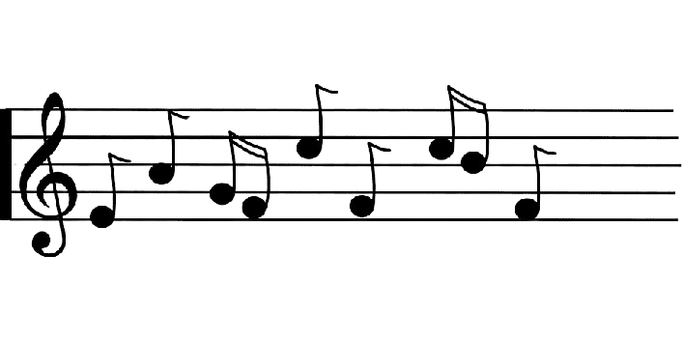
Motivation
Facilitating musical engagement for individuals of all backgrounds. Enhancing comprehension of processes such as the transcription of melodies and instrument tuning during musical performances without demanding specialized technical knowledge, promoting a more inclusive and accessible approach.
4

Slide 6
Objectives
Develop a real-time module for pitch recognition.
Create a real-time platform for plotting music sheets.
Integrate a sound reproducer that translates music sheets into audible melodies.
Implement a real-time rhythm recognition system.
Design a user-friendly graphical user interface (GUI).
5

Slide 7
Objectives
Develop a real-time module for pitch recognition.
Create a real-time platform for plotting music sheets.
Integrate a sound reproducer that translates music sheets into audible melodies.
Implement a real-time rhythm recognition system.
Design a user-friendly graphical user interface (GUI).
5

Slide 8
2
State Of The Art
Pitch recognition
Rhythm recognition
Market Analysis
nd.
Computational Audio – 2 of Master in Electrical and Computer Engineering
6

Slide 9
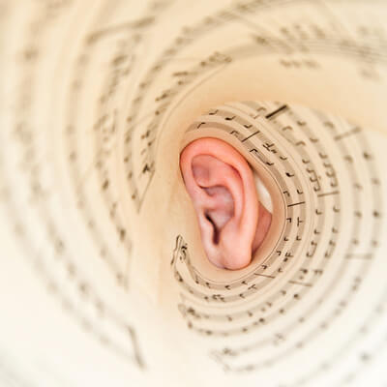
Pitch recognition
Pitch recognition is the process of analyzing and identifying the specific musical within an audio signal using the frequencies present in the signal.
1
3
2
Auto-Correlation
Cepstral Analysis
Find the highest peek in the autocorrelation.
The index of the peek is the f0.
Analysis of the audio signal into the cepstral domain.
Separation of vocal tract and excitation source characteristics.
Mitigate the influence of factors like noise
Deep-Learning
Neural networks to learn complex patterns in signals
High accuracy
7

Slide 10
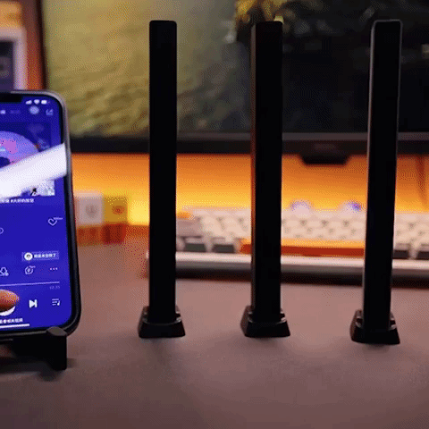
Rhythm recognition
Rhythm recognition is the analysis of temporal patterns in audio signals, identifying beats and accents to understand and reproduce musical rhythm.
3
1
2
Pattern Matching
Onset
Compares input rhythmic patterns with predefined templates
Identify similarities and patterns within the rhythm.
Analyzing energy and spectral flux to identify discontinuities in the audio data.
Machine-Learning
Deep learning.
Recurrent Neural Networks.
Long Short-Term Memory Networks.
8

Slide 11
Market Analysis
Drivers
Tech Advancements
Digital Music Industry Growth
3
Competition
Challenges
Key Players: VocalTuner, Nail the Pitch, Vocal Monitor, Pocket Pitch - The Singer App, Singscope.
Innovation: deep learning, Customization and User Profiles and Visual Feedback
Audio Quality Variability
Real-time processing
2
4
Market Overview
1
5
Opportunities
Market Size: Growing demand from education and music production
Definition: Instruments converting musical pitch from audio signals.
Expansion in Emerging Markets
Real-time processing and adaption
9

Slide 12
3
Adopted Solution
Pitch Detection Algorithm
Fundamental Frequency Calculation Algorithm
Technologies
nd.
Computational Audio – 2 of Master in Electrical and Computer Engineering
10

Slide 13
Objective: While the microphone is on, output the pitch of audio segments with T seconds of duration and filter the ones that are composed of noise
Pitch Detection Algorithm
Segment
Segment
Segment
Frame
Frame
Frame
Frame
Frame
Frame
Frame
Frame
Frame
Microphone ON
F0
F0
F0
F0
F0
F0
F0
F0
F0
Pitch
Pitch
Pitch
11

Slide 14
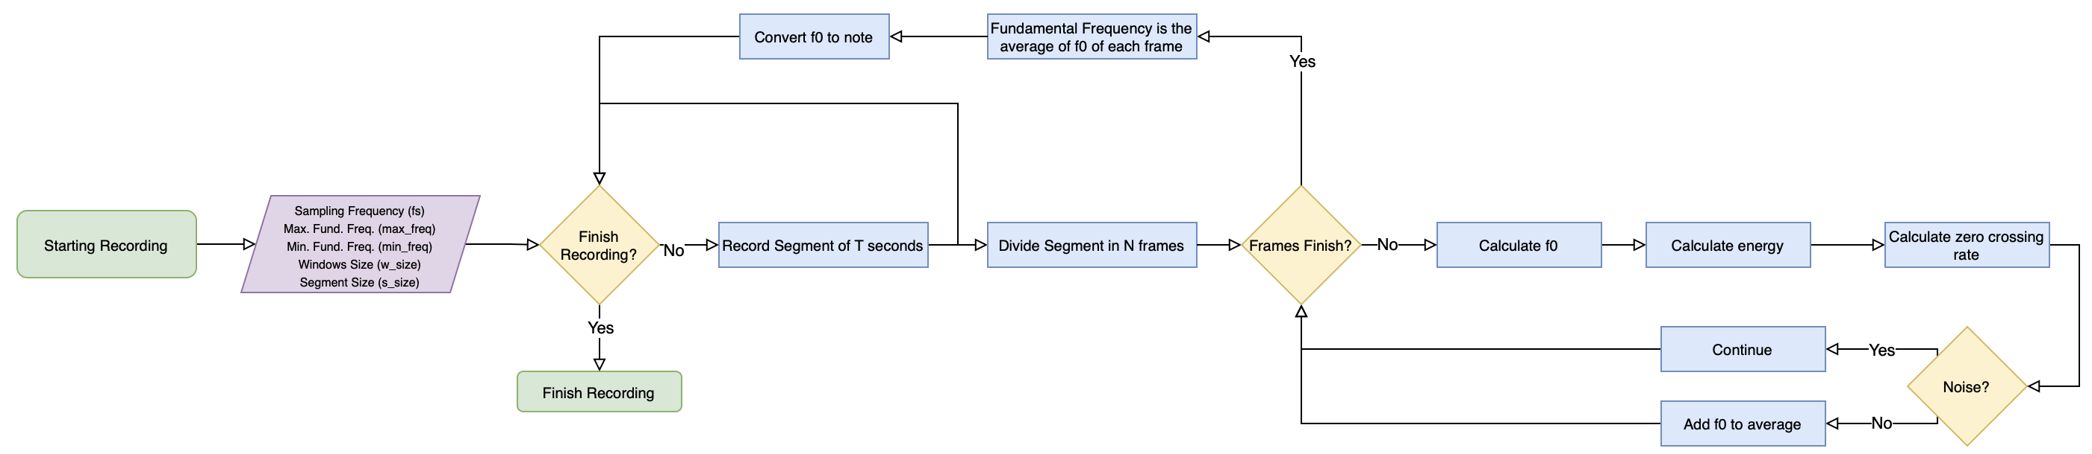
Pitch Detection Algorithm
Objective: While the microphone is on, output the pitch of audio segments with T seconds of duration and filter the ones that are composed of noise
12

Slide 15
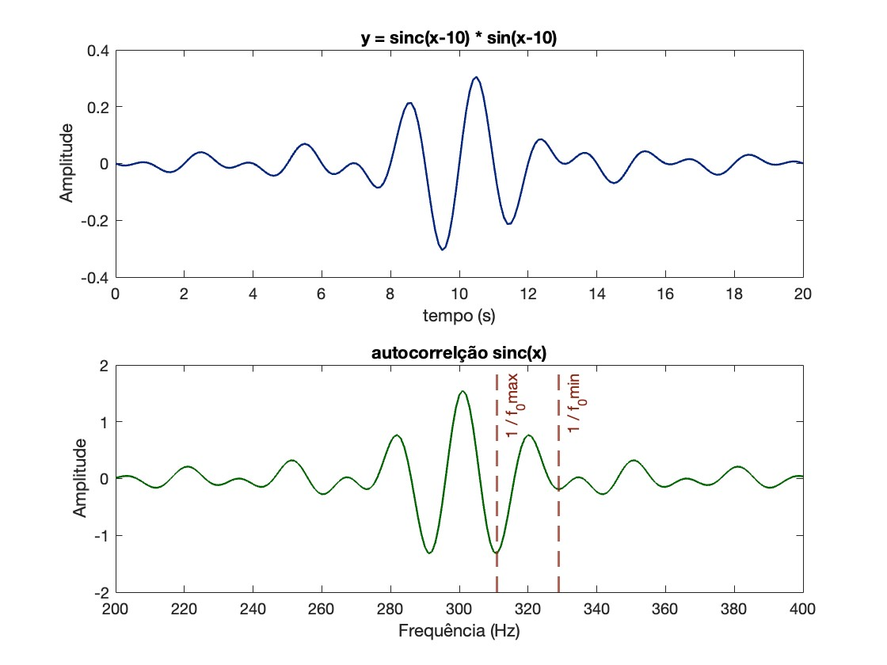
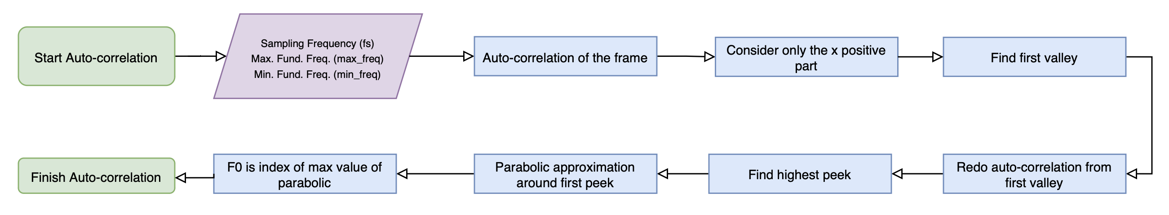
Fundamental Frequency Calculation Algorithm
Objective: Accurately calculate the fundamental frequency of a frame with t seconds.
13

Slide 16
Utilization of technologies to achieve the outcome
Technologies
QT Designer
Simple GUI development
Python
Objected oriented
MACOS
Operative system
14

Slide 17
4
Implementation
Class Diagram
Processes
Melody generation
nd.
Computational Audio – 2 of Master in Electrical and Computer Engineering
15

Slide 18
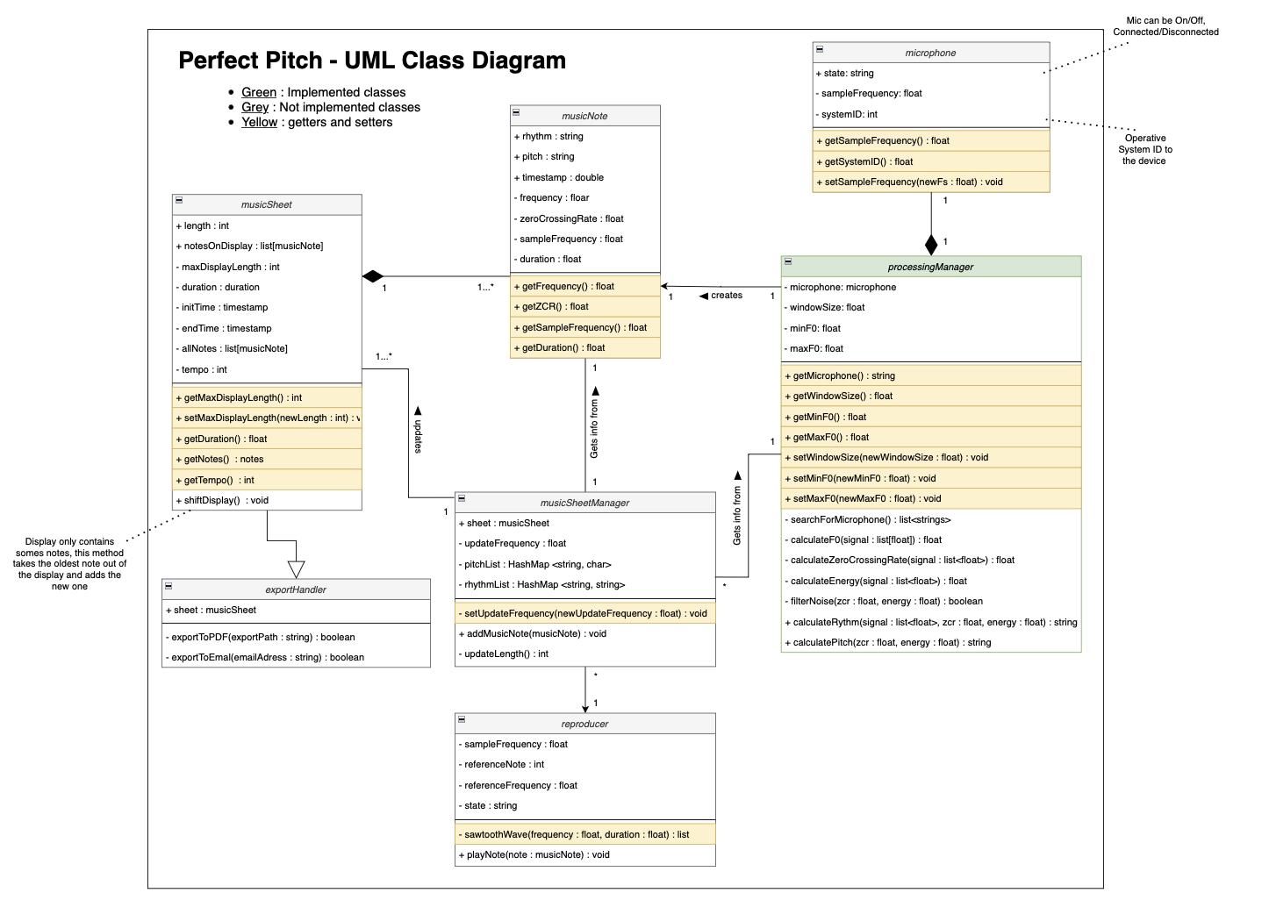
Class Diagram
16

Slide 19
Processes
The system is composed of 3 processes:
Recording
Processing
Update Display
Recording_1
Recording_2
Recording_3
Signal
Signal
Processing_1
Processing_2
Update Display_1
Update Display_2
Update Display_3
t
T
2T
17

Slide 20
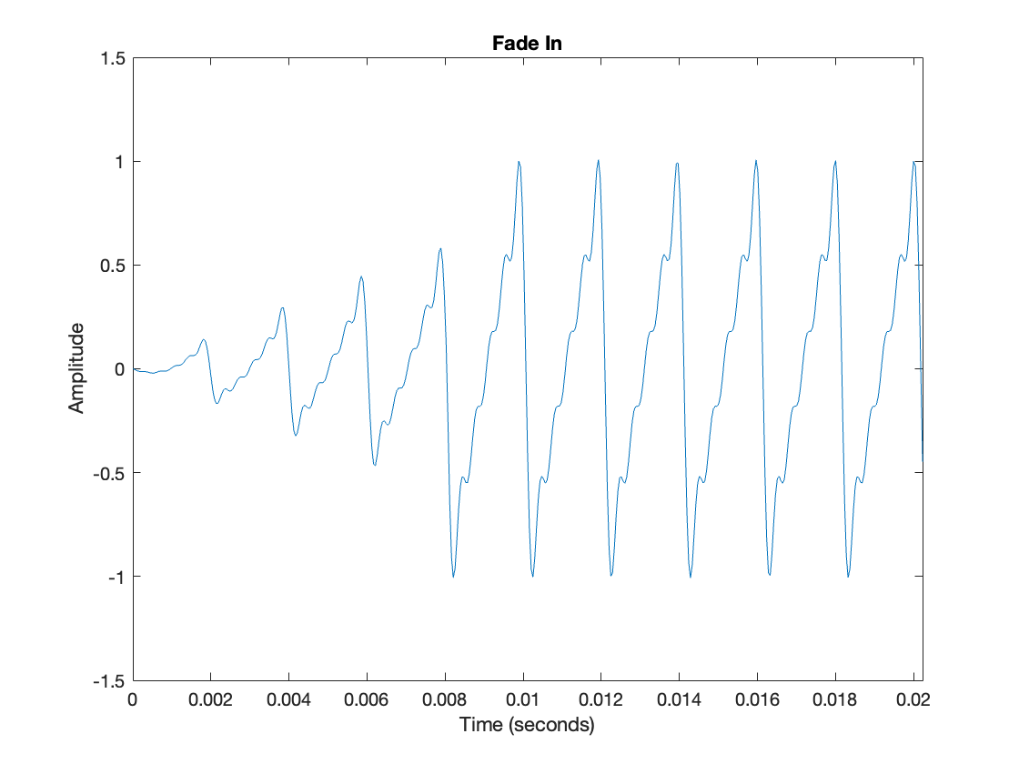
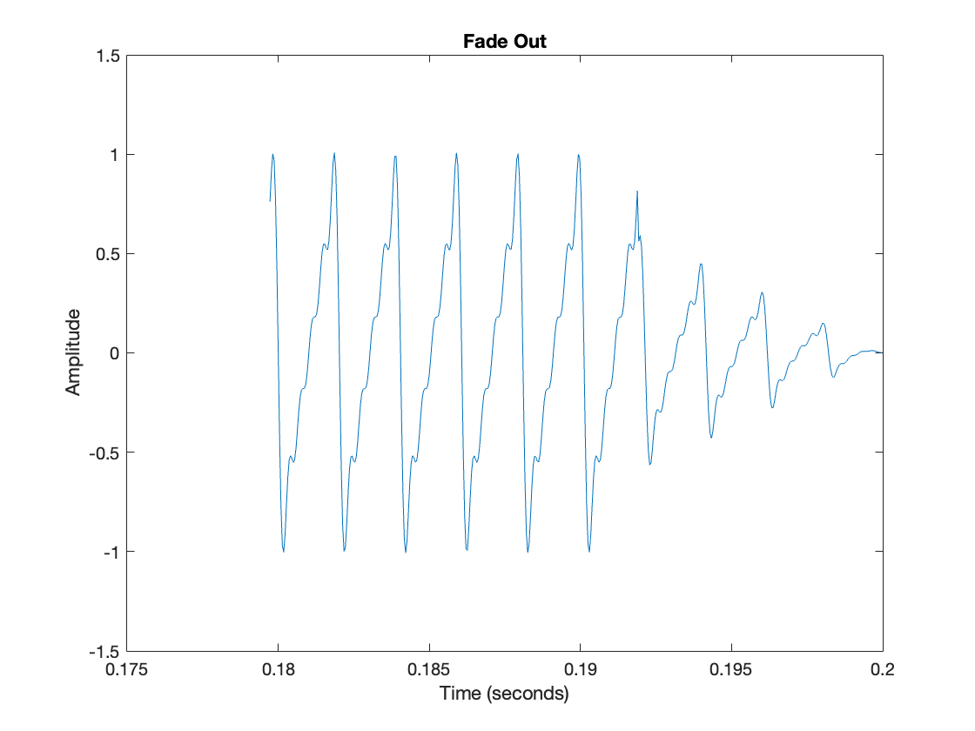
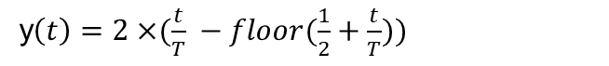
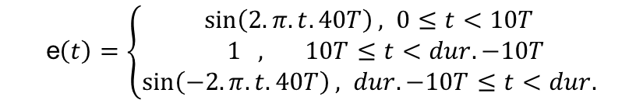
Melody Generation
Sawtooth waves with a given frequency, duration, and fixed sample frequencies. Fade in and fade out.
e$\left(t\right)=\left\{\begin{aligned}\sin\left(2.π. t.40T\right), 0≤t<10T \\ 1 , 10T≤t<dur. −10T \\ \sin\left(−2.π. t.40T\right), dur. −10T≤t<dur.\end{aligned}\right.$
y$\left(t\right)=2×⁡(\frac{t}{T} −floor(\frac{1}{2}+\frac{t}{T}))$
18

Slide 21
5
Final
Results
Test - Pitch recognition
Test - Onset
Demo
Conclusions
nd.
Computational Audio – 2 of Master in Electrical and Computer Engineering
19

Slide 22
Test – Pitch Recognition
Tests:
Test 1: 1s B2 1s pause T = 1s
Test 2: 1s different notes T = 1s
Test 3: 1s note with rhythm
 | Test 1 | Test 2 | Test 3
Pitch accuracy | 100 % | 100 % | 45 %
MSE f0 | 0.156 | 0.260 | -
Noise detection | 100 % | 100 % | -
20

Slide 23
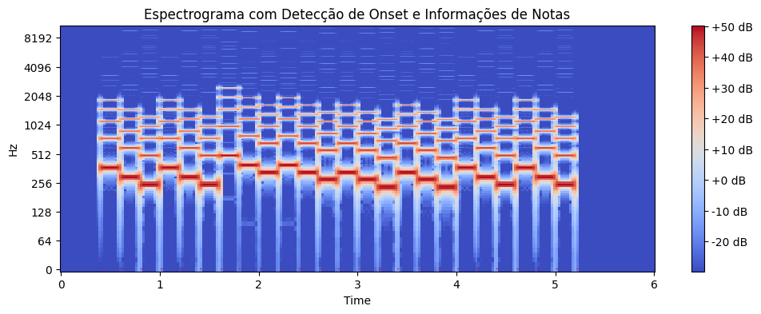
Test – Onset
Onset functions effectively but exhibits high sensitivity, especially in the presence of noisy sounds. Despite the application of filters, it tends to overly segment the signal.
21

Slide 24
Demo
22

Slide 25
Conclusions
Not Considering Rhythm
Pitch Recognition
Significant Limitation.
Exceptional performance even in moderately noisy conditions.
Reproducing Sheet Music
Exceptional performance, except for the occurrence of clips between notes.
User-Friendly Interface
Intuitive and responsive.
PerfectPitch – Online Melody Identifier
Project Objectives:
Enhancing Learning and Development
Four out of the five objectives have been successfully attained.
Developing Robust Methods for Perfect Pitch Calculation, Prototyping Online Pitch and Rhythm Detection, Implementing Object-Oriented Programming, and Learning New Technologies.
23

Slide 26
Thank You!
nd.
Computational Audio – 2 of Master in Electrical and Computer Engineering
Professor Doctor Diamantino Rui da Silva Freitas
André de Azevedo Barata
André Nogueira Soares
Eng. Eletrotécnica e de Computadores, Faculdade de Engenharia da Universidade do Porto
Porto, Portugal, up20190705@up.pt
Eng. Eletrotécnica e de Computadores, Faculdade de Engenharia da Universidade do Porto
Porto, Portugal, up201905318@up.pt
24

